Slide 1
History of Bangladesh
HST 103
T.3: Periodization (Ancient)

Slide 2
State formation and periods
Generally, the history of Bengal is divided into three periods: Ancient (AKA Early), Medieval and Modern
First statehood can be traced to a number of ‘janapadas’
Six most prominent ‘Janapada-s or kingdoms in Bengal (Banga(Vanga), Pundra, Gaura, Radha, Samatata, Harikela) – those were probably the earliest states in Bengal
These were followed by mightier states or empires like Maurya, Gupta, Pala, Sena and others

Slide 3
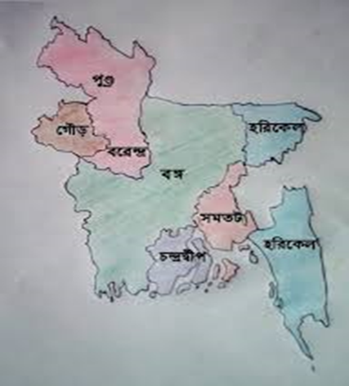
Ancient Janapadas

Slide 4
Maurya Empire (322–185 BCE)
The Mauryan Empire was founded by Chandragupta Maurya around 321 BCE and ended in 185 BCE - first pan-Indian empire that covered most of the Indian region.
Ashoka, the third leader of the Mauryan Empire - left his mark on history by erecting large stone pillars inscribed with edicts issued by him. The edicts are known together as Ashoka’s Dhamma.
After leading a bloody campaign against Kalinga (a region on the central-eastern coast of India), Ashoka decided to stop blood shedding and turned to Buddhism with its principle of nonviolence.

Slide 5
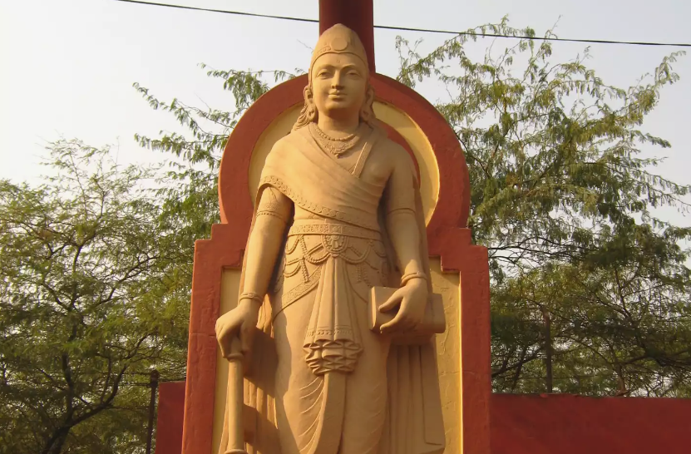
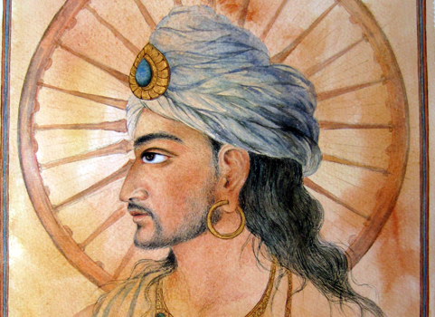
Chandragupta Mauryan (340-297) B.C.E.
Ashoka (304–232) B.C.E.

Slide 6
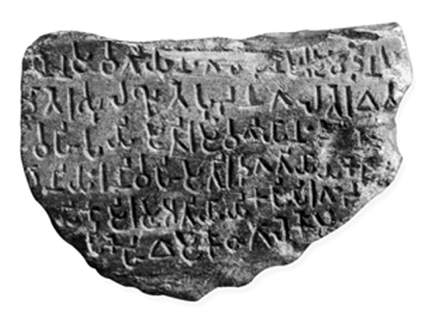
Mahasthan Brahmi Inscription
A fragmentary inscription in Brahmi characters, discovered at mahasthan in the Bogra district of Bangladesh, is the earliest epigraphic record (3rd century BC) in Bengal. It is a small record of seven lines, incised on a circular stone, parts of which are broken. The inscription is palaeographically datable to the Maurya age (c 3rd century BC). The language of the inscription is Prakrit, but the influence of Magadhi is discernible

Slide 7
Gupta Empire (4th - 6th CE)
Ancient Indian empire - considered as the Golden Age of India - first local self-government in the history of Bengal - peace and prosperity prevailed for nearly 3 centuries
Most notable rulers were Chandragupta I, Samudragupta, Chandragupta II and others
Gupta rulers were based in Magadha (now Bihar) - they founded an empire over most of India. Gupta rule spread over Bengal probably in the reign of Chandragupta I or Samudragupta towards the end of the 3rd or the beginning of the 4th century AD. Eulogical inscriptions (prashasti lipi), copperplates, coins, literary evidences, and foreign accounts bear testimony to the existence of Gupta rule in Bengal.

Slide 8
Gauda kingdom: King Shashanka ( C. 600-636 CE)
Shashanka the first important king of ancient Bengal.
Considered by some scholars to be the pioneering king of a unified Bengali state - Shashanka established a kingdom centered in the citadel of Gauda.
Besides the seal-matrix of 'Shri Mahasamanta Shashanka' from Rohtasgarh and the contemporary literary accounts of Banabhatta (court poet of king Harshavardhana) and the Chinese pilgrim hiuen-tsang and the Buddhist text Aryamanjushrimulakalpa are important sources of information about this period.

Slide 9
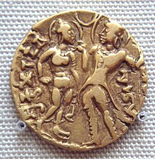
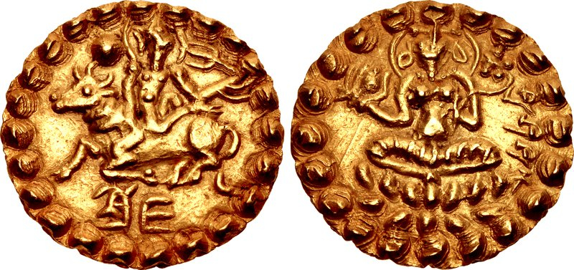
Coinage of Shashanka Deva
Queen Kumaradevi and King Chandragupta I, depicted on a gold coin

Slide 10

Matsya Nyaya and the Pala Empire
Pala Dynasty (750-1160 CE)
After the death of Shashanka there was a period of lawlessness (Matsyanyayam)- The Kautilya Arthaxastra (1.4.13-14) defines the term as: When the law of punishment is kept in abeyance, it gives rise to such disorder as is implied in the proverb of fishes, ie, the larger fish swallows a smaller one, for in the absence of a magistrate, the strong will swallow the weak.
To overcome It, a person named Gopala was made the king.
The Pala Empire (founded by Gopala) during 750–1120 CE was a Bengali kingdom and the last Buddhist imperial power on the Indian subcontinent.
Gopala reigned from about 750–770 CE and extended his control over most of Bengal
The Somapura Mahavihara built by Emperor Dharmapala is the greatest Buddhist monastery in the Indian subcontinent
The empire reached its peak under Emperor Dharmapala (770–810) and Devapala (810-850) - Dharmapala extended the empire into the northern parts of the Indian subcontinent

Slide 11
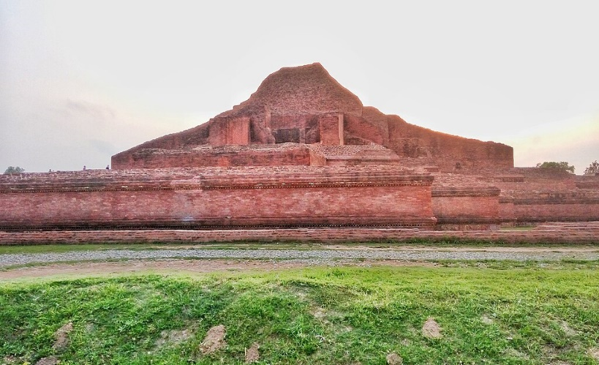
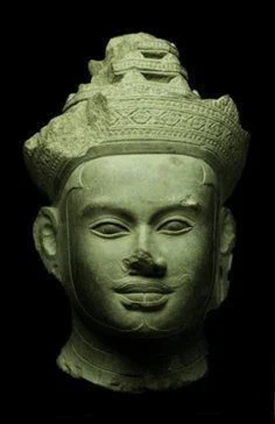
Somapura (Paharpur) Mahavihara
The Emperor Devapala

Slide 12
Sena Dynasty (1095-1250 CE)
Vijaya Sena, the second dynasty ruler, defeated the last Pala emperor, Madanapala, and formally established his reign - Sena Dynasty succeeded in bringing Bengal under one ruler during the 12th century
The fourth Sena king, Lakshmana Sena, expanded the empire beyond Bengal into Bihar, Assam, Odisha, and probably Varanasi. Lakshmana was later defeated in 1204 CE by the nomadic Turkic Muslims and fled – he ruled a few more years in eastern Bengal (Bikrampur)

